Slide 1
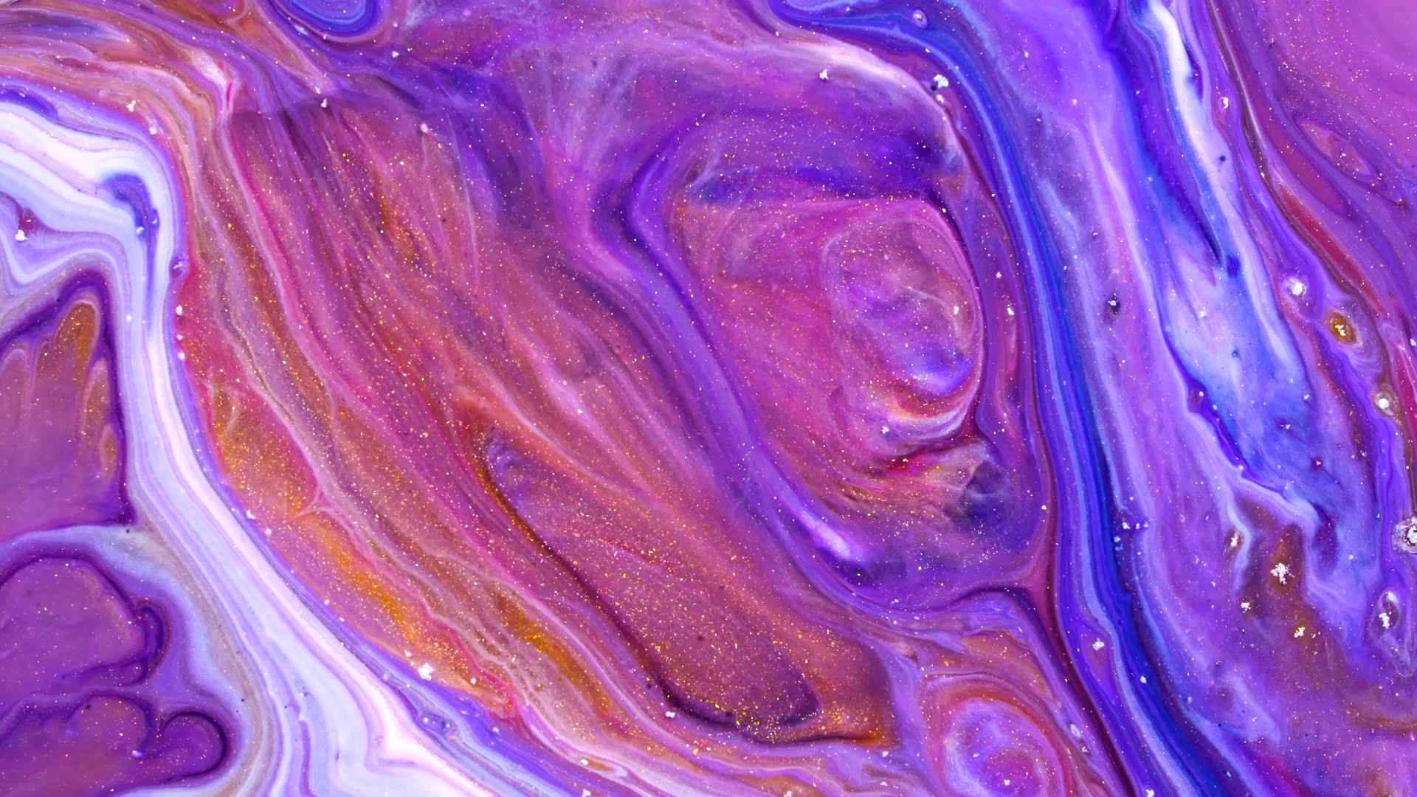
Art

Slide 2
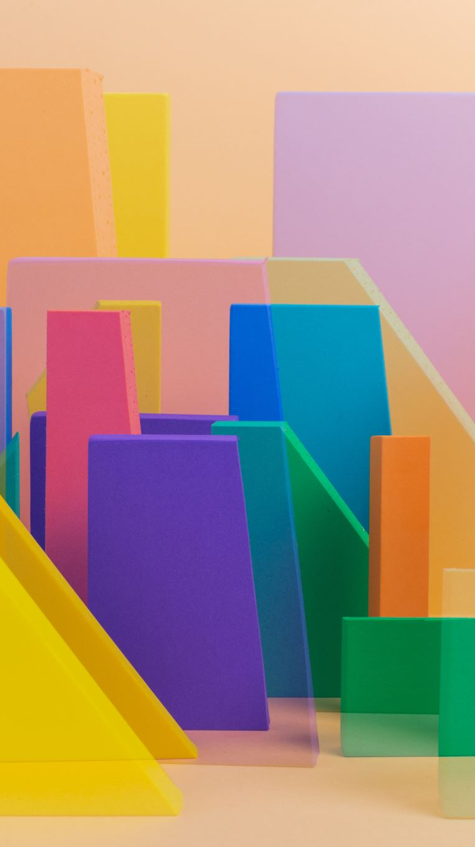
What is art?
Art ,a visual object or experience consciously created through an expression of skill or imagination. The term art is media such as painting , sculpting, printmaking , drawing , decorative arts , photography, and installation.

Slide 3
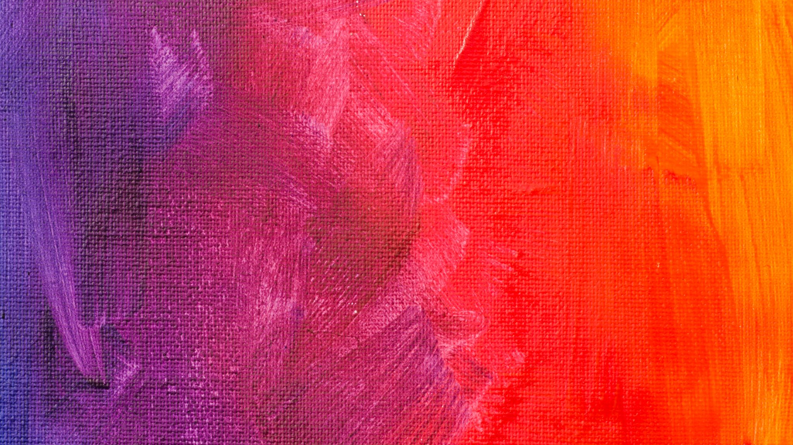
What is painting?
Painting, the expression of ideas and emotions, with the creation of certain aesthetic qualities, in a two-dimensional visual language. The elements of this language—its shapes, lines, colours, tones, and textures—are used in various ways to produce sensations of volume, space, movement, and light on a flat surface.

Slide 4

Natural Art

Slide 5
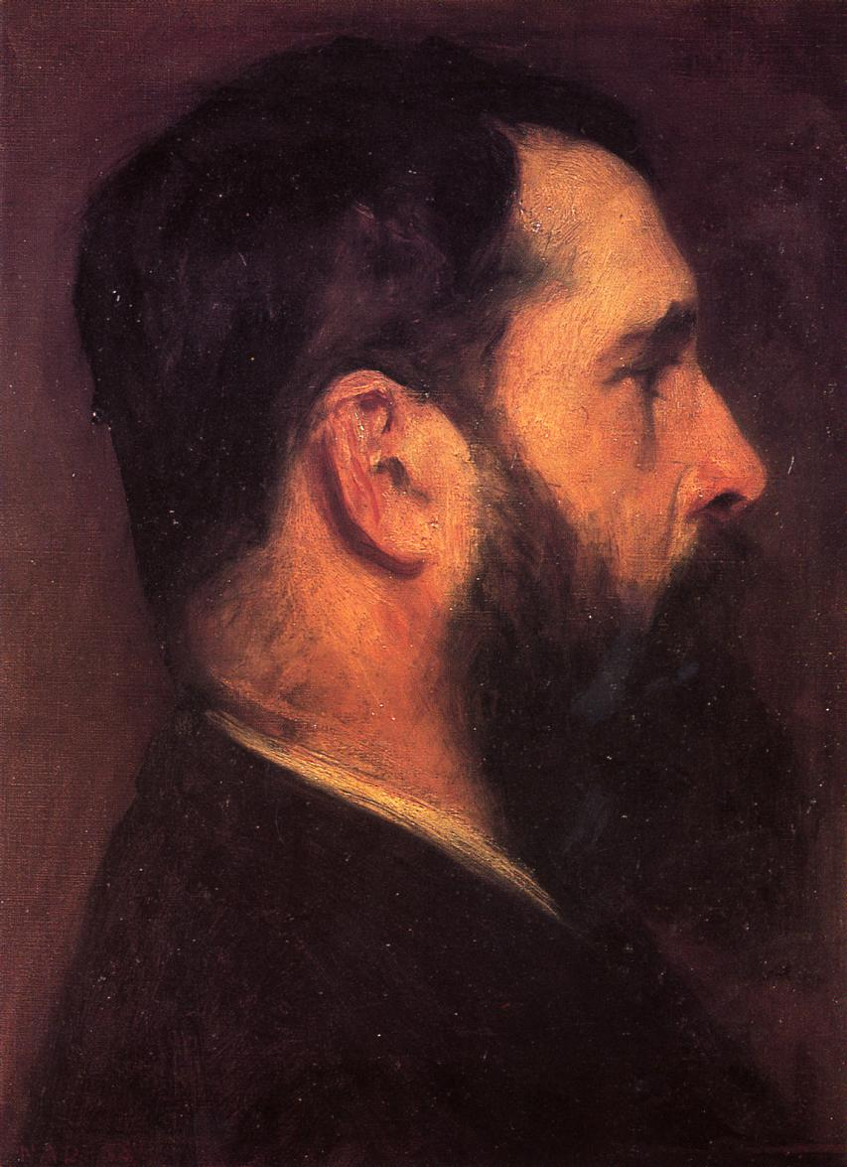
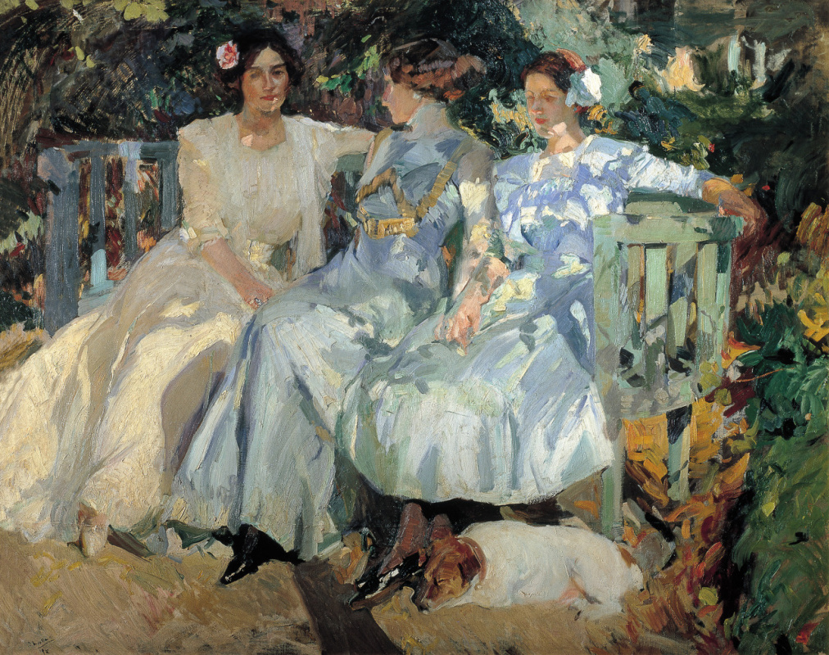
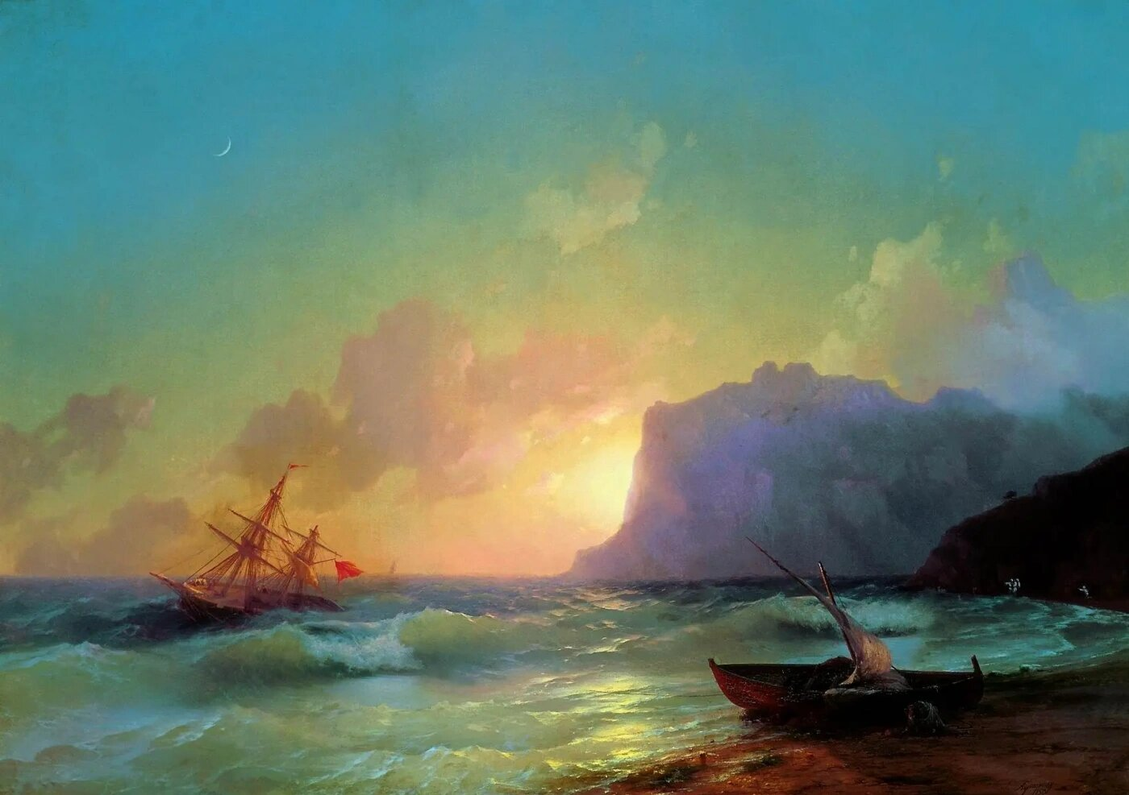
Different paintings
John Singer Sargent, Portrait of Claude Monet, 1887
Joaquín Sorolla, My Wife and Daughters in the Garden, 1910
Ivan Aivazovsky, Sea, Koktebel, 1853

Slide 6

Art Fun Facts
The starry night was painted in a psych ward!
Jackson Pollock is famous for his drip paintings!
Artist Van Gogh only sold one painting during his lifetime!
There 12 definitions of the word art in the Oxford dictionary!
Art competitions were once part of the Olympics!

