Slide 1
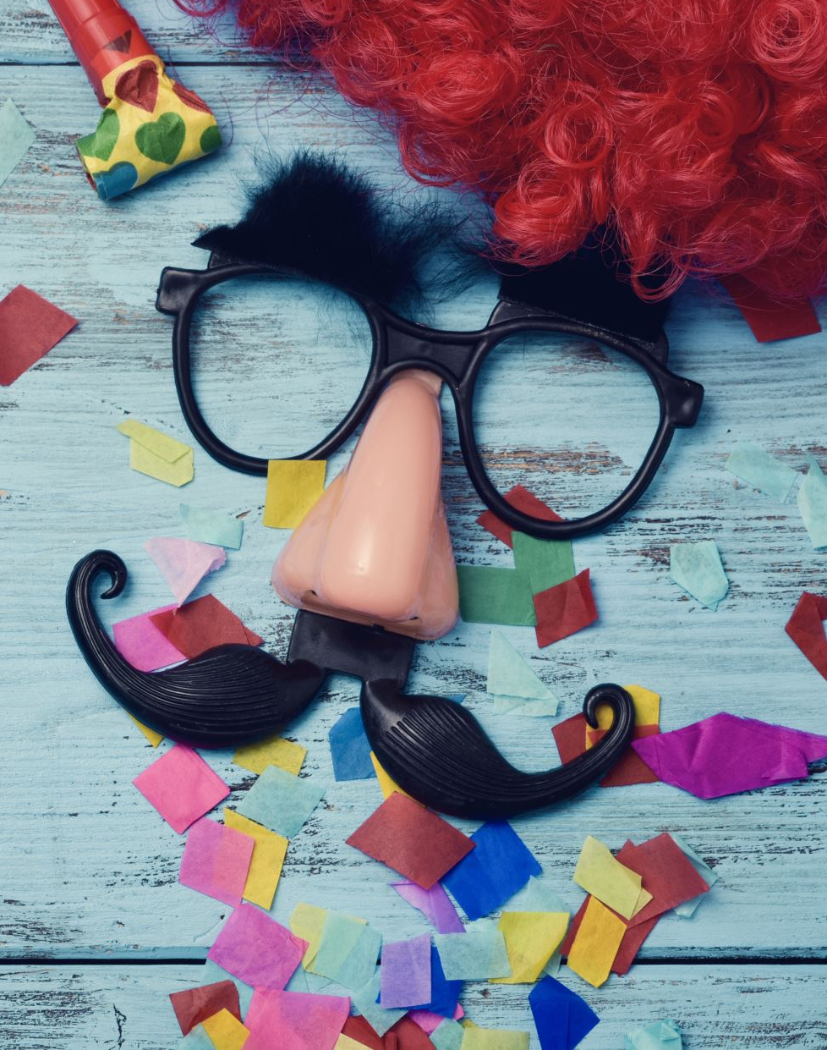
April Fools Day

Slide 2
Contense page
Pranks
How to do them

Slide 3
Pranks
The milk freezer
Snake in the draw/bed
Bugs in your ice
Pillow prank
Salty drink
Tricky T.V remote
Foamy shoes

Slide 4

How to do them

Slide 5
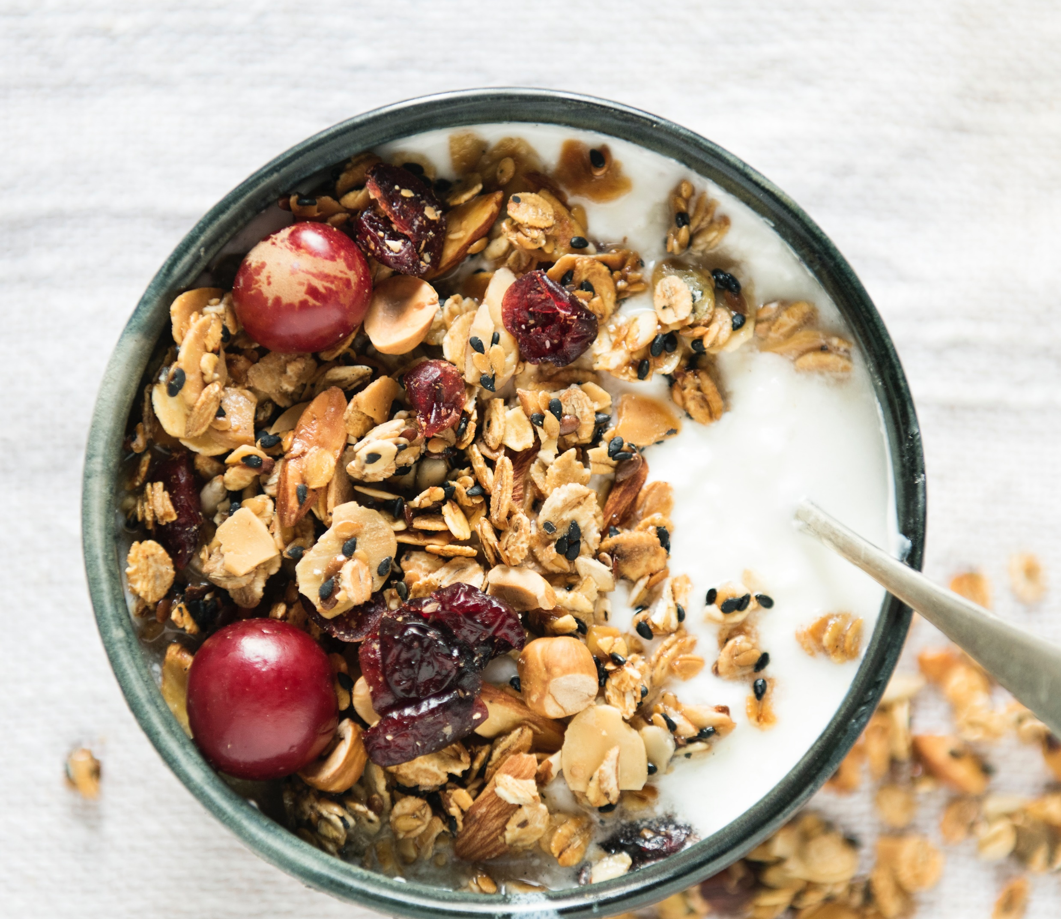
The milk freezer
Put cereal and milk in a bowl and let it freeze overnight. When your hungry family try to dig in, they’ll get quite the surprise.

Slide 6
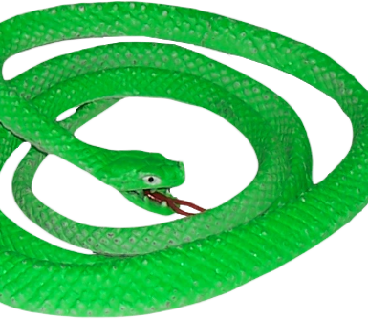
Snake
Put a rubber snake in the bed or draw
This Photo by Unknown Author is licensed under CC BY

Slide 7
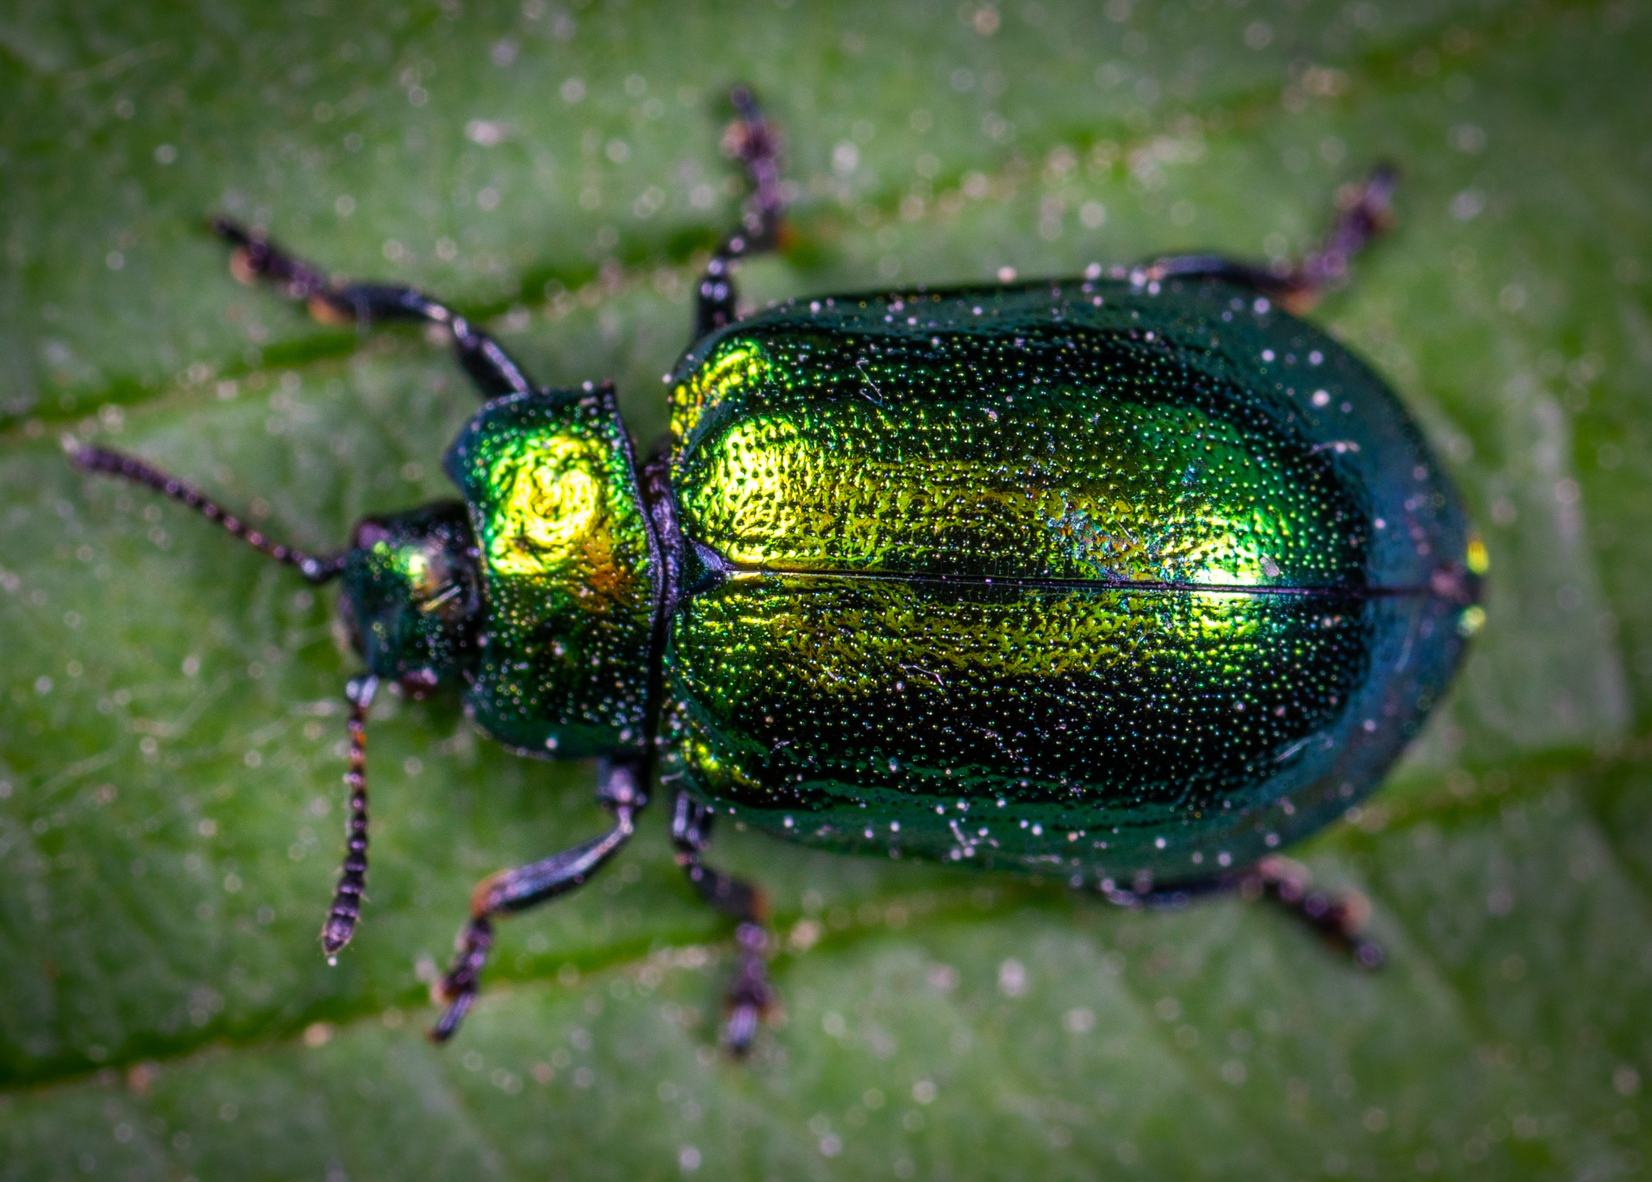
Bugs in your ice
This oldie-but-goodie prank is easy to make at home with this tip. Add almost boiling water to the ice cube trays and toss in a few plastic bugs. The hotter the water, the more clear the ice will be when frozen.

Slide 8
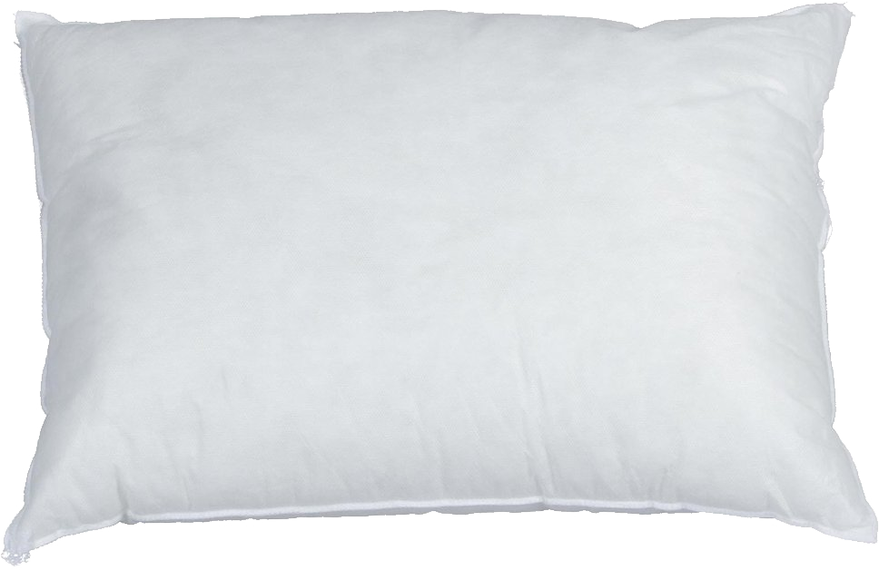
Pillow prank
Just when they thought April Fools’ Day was over, here’s one last prank. Remove the pillows and fill their pillowcases with several partially inflated balloons. When they put their head down to sleep, they’ll realize you got the last April Fools’ laugh. Obviously if you have younger children, you’ll want to take the balloons out of their room before they drift off to sleep.
This Photo by Unknown Author is licensed under CC BY-NC

Slide 9
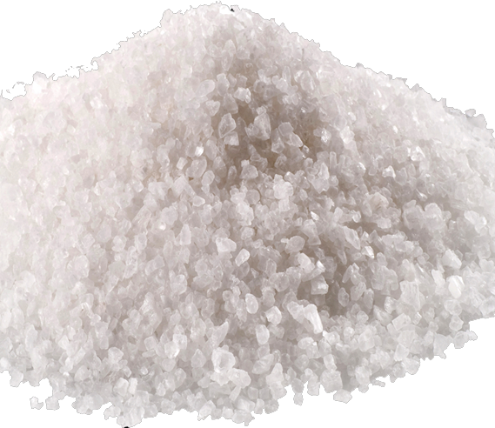
Salty drink
Instead of adding sugar to the drink, add salt! Your kids may be excited for the first sip of the warm, sweet drink, but that first sip will surprise them. (Make them a mug of regular hot chocolate, too, so that they aren’t too disappointed!)
This Photo by Unknown Author is licensed under CC BY-NC

Slide 10

Tricky T.V remote
Ever had to mediate a family fight over who gets to choose the channel? This prank will leave everyone equally confused. Put a piece of black electrical tape over the remote sensor on your television, and watch your family try to change the channel with no luck.
This Photo by Unknown Author is licensed under CC BY-SA

Slide 11
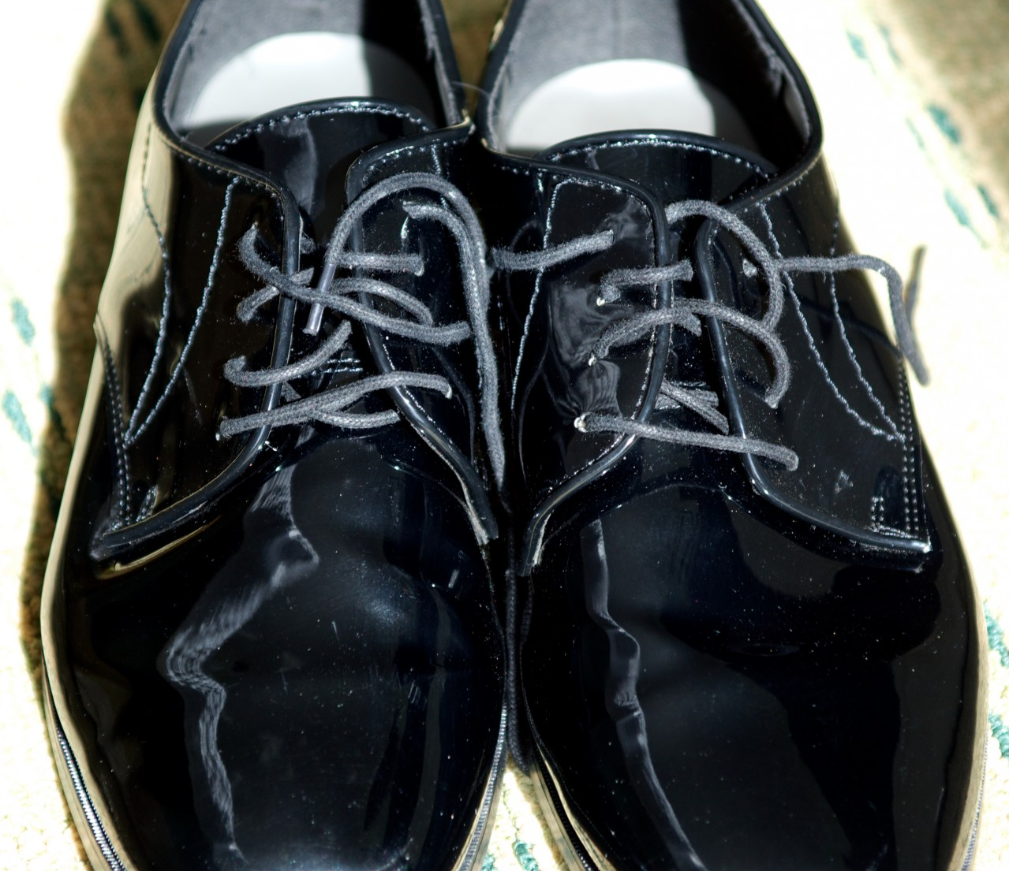
Foamy shoes
When your parents try to put their shoes on before a party on Sunday, they’ll be thinking what was in their shoes all day! Stuff the toes of your parent's shoes with shaving cream, and watch them struggle to look at their foamy feet are !

